Slide 1

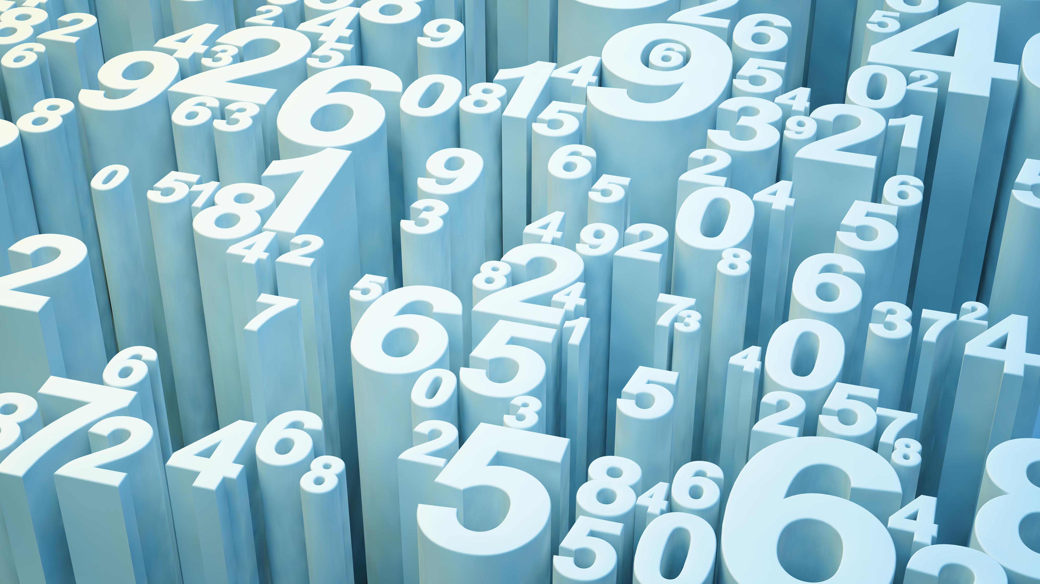
San Francisco Crime Classification
Nouran Hisham

Slide 2
San Francisco Crime
About:
It’s a dataset from Kaggle about all the crimes taking place in San Francisco for the past 12 years, how often each crime is, when it took place, where it took place and how the police forces there handled it.
Our job is to predict what crime is most likely to take place given a certain time and location, this should be done depending on the 12-year worth of data on this matter provided by Kaggle.
All work in this project is done only on the training data excel file.

Slide 3
San Francisco Crime
Dataset:
Dates - timestamp of the crime incident
Category - category of the crime incident (only in train.csv). This is the target variable you are going to predict.
Descript - detailed description of the crime incident (only in train.csv)
DayOfWeek - the day of the week
PdDistrict - name of the Police Department District
Resolution - how the crime incident was resolved (only in train.csv)
Address - the approximate street address of the crime incident
X - Longitude
Y – Latitude

Slide 4
San Francisco Crime
Project Summary:
Plots were created to help understand the data better.
Data cleansing was applied thoroughly to be able to extract only the useful data to work on.
3 different classification models were made (random forest, decision tree, KNN).
Parameters tuning was applied.
Comparison between the accuracy of the 3 models.

Slide 5
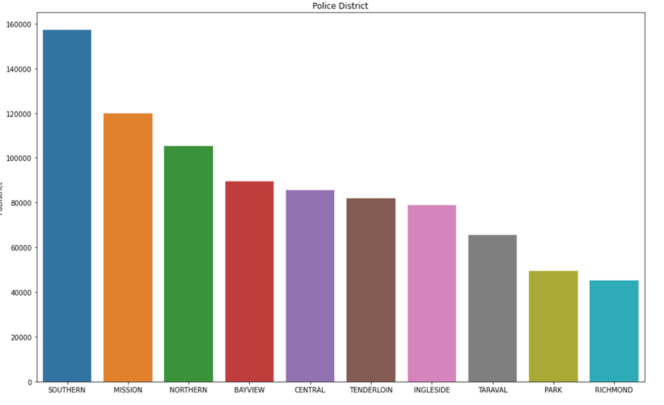
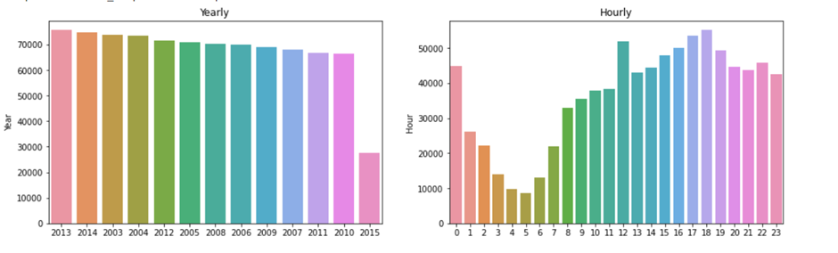
Main charts/plots
Bar plot for district
Shows how frequent each crime is in each district
Bar plot for years
Shows which year has the most and least crimes
Bar plot for hours
Shows which hour is most likely to have a crime in

Slide 6
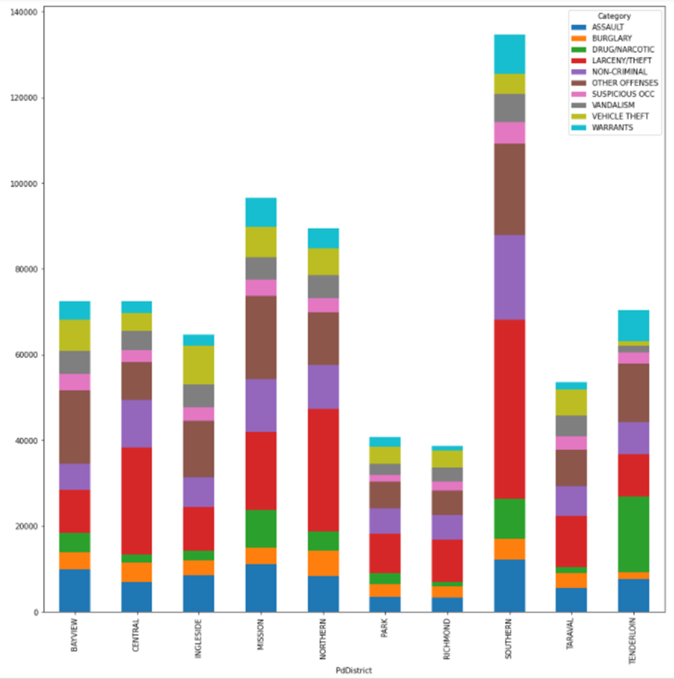
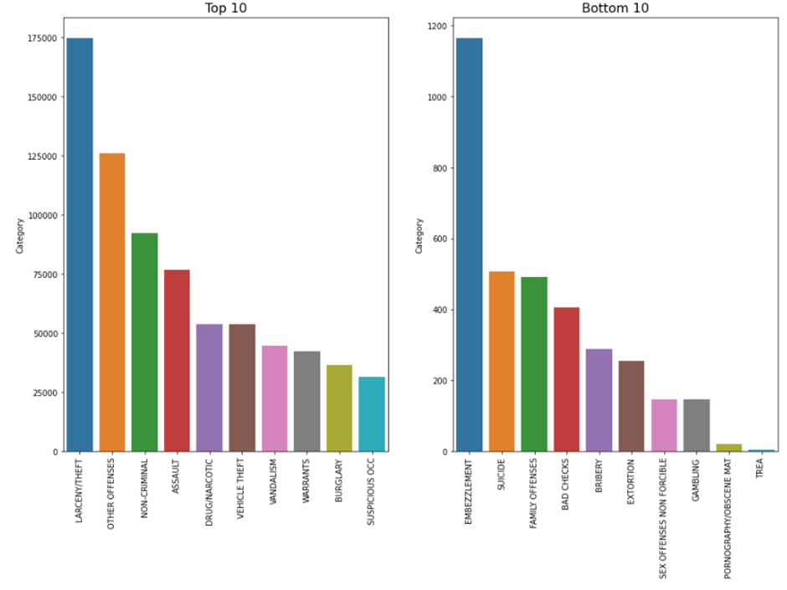
Main charts/plots
Stacked bar plot
Shows the number of crimes in each district
Bar plot top 10 crimes
Bar plot for bottom 10 crimes

Slide 7
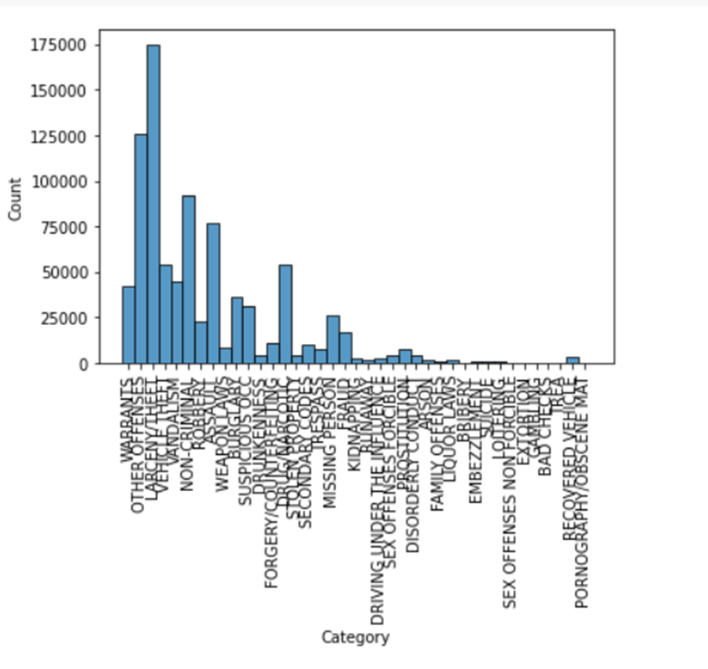
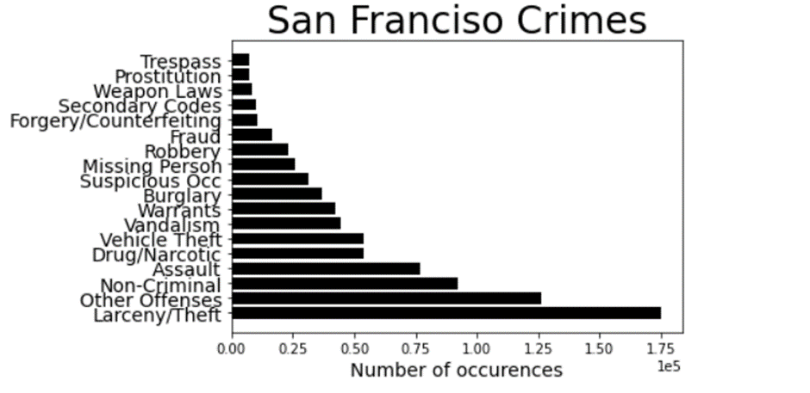
Main charts/plots
A histogram and a bar plot to show the most and least frequent crimes in San Francisco for the past 12 years.

Slide 8

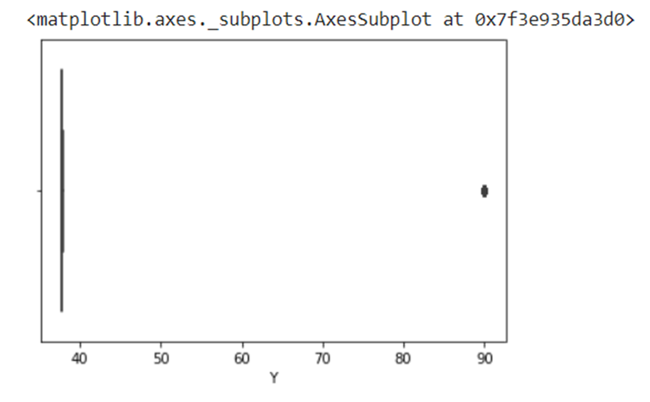
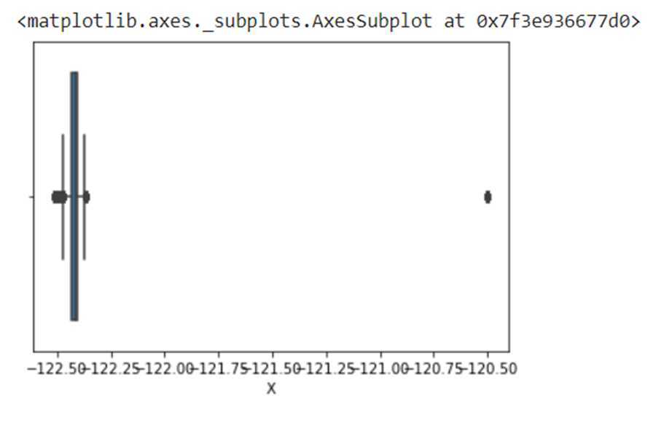
Data Cleansing
Checked for outliers in the data with the aid of box plots.
Outliers were only found in (X-Longitude) and (Y-Latitude)

Slide 9
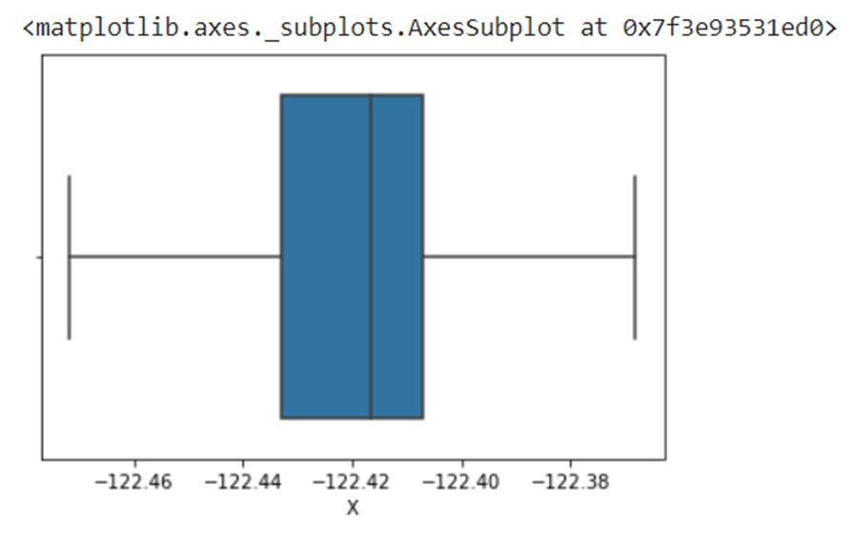

Data Cleansing
Outliers found were fixed using a function that calculates the range, upper and lower whiskers.
This function puts the outlier values with whichever lower or upper whisker it’s nearest to.

Slide 10
Data Cleansing
Checked for null values.
This was done using the describe(include=”all”) and shape functions.
All columns were found to have 878049 value which is the actual total number of rows in the dataset.
Accordingly, no null values were found.

Slide 11
Data Cleansing
Tried to minimise the number of features.
Minimising the number of features facilitates the training process.
This was done using the drop function.
Descript, Resolution, Dates, Address columns (features) were removed from the data.

Slide 12
Data Cleansing
Modifying data types is an important part of data cleansing.
Some data types are irrelevant and make it harder for the model to be trained such as strings.
LabelEncoder() function was used to change such data types from strings to integers.
PdDistrict, Month, DayOfWeek were the features of string data type that were changed to integers.

Slide 13
Classification Models
Random Forest Classifier:
A random forest is a meta estimator that fits a number of decision tree classifiers on various sub-samples of the dataset and uses averaging to improve the predictive accuracy and control over-fitting.
This model had the following accuracy score: 0.2527817322475941

Slide 14
Classification Models
Random Forest Classifier:
Random Forest Classifier has a hyperparameter that when changed can affect the accuracy of the model, this hyperparameter is n_estimators which is the number of trees in the forest.
Before tuning this parameter was set to 10 and after tuning it was set to 80.
Accuracy score after tuning was: 0.2527817322475941

Slide 15
Classification Models
Decision Tree Classifier:
It is a tree-structured classifier, where internal nodes represent the features of a dataset, branches represent the decision rules, and each leaf node represents the outcome.
In a Decision tree, there are two nodes, which are the Decision Node and Leaf Node.
It has no hyperparameters, so no tuning was done on it.
This model had the following accuracy score: 0.2387164740048972

Slide 16

Classification Models
K-Nearest Neighbour Classifier:
KNN algorithms use data and classify new data points based on similarity measures (e.g. distance function).
This model had the following accuracy score: 0.18590626957462558
Classification is done by a majority vote to its neighbours.

Slide 17
Classification Models
K-Nearest Neighbour Classifier:
KNN classifier has a hyperparameter called n_neighbours which is the number of neighbours to check for the distance from the starting point.
Before tuning this parameter was set to 2 and after tuning it was set to 15.
Accuracy score after tuning was: 0.18590626957462558

Slide 18
San Francisco Crime
Conclusion:
The best model of these three models was Random Forest Classifier model.
Future work that may be made to enhance the models is getting a larger dataset and decreasing the non-necessary features.

Slide 19
Thank you!

